Slide 1
UPPER SIXTH ARTS
GEOGRAPHY
Lesson 23
Weber's Least-Cost Model
Notes:
Good morning, class, and welcome to our geography lesson. I am your geography teacher, Mr Kamdem. Today we are starting Lesson 23: Weber's Least-Cost Model.

Slide 2
CLASS INFO
Class, Chapter and Duration
Class | Upper Sixth Arts
Chapter | Module 6: Understanding and managing the dynamics of economic activities across the world in general and Cameroon in particular
Duration | 2 periods (2 × 50 minutes)
Notes:
This lesson is for Upper Sixth Arts. It belongs to Module 6: Understanding and managing the dynamics of economic activities across the world in general and Cameroon in particular. We shall need 2 periods to cover it.

Slide 3
IDENTIFICATION
Lesson Identification
Topic | Theories of Industrial Location
Sub-topic | Theories of Industrial Location
Lesson | Lesson 23: Weber's Least-Cost Model
Notions / Concepts | Weber, least-cost location, material index, locational triangle, isodapane, labour, agglomeration.
Syllabus focus | Aim and assumptions; the material index; location factors (transport, labour, agglomeration); applicability and criticisms.
Competence | Learners are able to explain Weber's model and assess it.
Notes:
Our topic is Theories of Industrial Location, and the sub-topic is Theories of Industrial Location. The key notions we shall use today are: weber, least-cost location, material index, locational triangle, isodapane, labour, agglomeration. At the end, you should be able to do this: learners are able to explain Weber's model and assess it.

Slide 4

HOMEWORK CORRECTION
Correction of the Homework
Question (Lesson 22: New Trends in Manufacturing):
Name three multinationals present in Cameroon and their products.
Notes:
Before we start the new lesson, let us correct the homework I gave you at the end of Lesson 22: New Trends in Manufacturing. The question was: Name three multinationals present in Cameroon and their products. Take out your exercise books.

Slide 5
HOMEWORK CORRECTION
Correction: Possible Answer
Examples of multinationals in Cameroon: Nestlé (food products), Total (fuel), MTN and Orange (telecommunications), Guinness (drinks), Bolloré (transport and logistics).
Notes:
Here is a good answer. Examples of multinationals in Cameroon: Nestlé (food products), Total (fuel), MTN and Orange (telecommunications), Guinness (drinks), Bolloré (transport and logistics). Compare it with your own answer and correct your work in red.

Slide 6
LESSON PLAN
Lesson Plan
Correction of the homework
Objectives and recall
Real-life situation and action to take
Learning activities
Board summary
Evaluation, remediation and homework
Notes:
Here is the plan of our lesson today. First, we shall correct the homework. Then we shall look at the objectives and recall what you already know. After that, we shall study a situation from real life and the action to take, and do the learning activities. Finally, we shall copy the board summary, do the evaluation and the remediation, and I will give you the homework.

Slide 7
OBJECTIVES
Objectives
By the end of this lesson, you should be able to:
State the aim and assumptions of Weber's model.
Explain the material index and the location triangle.
Notes:
Take your time to copy this part; we will continue together.

Slide 8
OBJECTIVES
Objectives (continued)
Explain labour and agglomeration and assess the model.
Notes:
By the end of this lesson, you should be able to do three things. Number 1: state the aim and assumptions of Weber's model. Number 2: explain the material index and the location triangle. Number 3: explain labour and agglomeration and assess the model.

Slide 9
PREVIOUS KNOWLEDGE
Previous Knowledge
Transport costs affect location.
Some materials lose weight when processed.
Notes:
Let us first remember what you already know. Transport costs affect location. Some materials lose weight when processed. Keep this in mind, because we shall build on it today.

Slide 10
REAL-LIFE SITUATION
Situation in Real Life
A sugar mill is built next to the cane fields at Mbandjock, while a soft drink factory is built in Douala. A learner asks if there is a rule for choosing the cheapest location.
Notes:
Listen carefully to this situation from real life. A sugar mill is built next to the cane fields at Mbandjock, while a soft drink factory is built in Douala. A learner asks if there is a rule for choosing the cheapest location. Think about it, because I am going to ask you some questions.

Slide 11
REAL-LIFE SITUATION
Situation: Question 1
What is the problem in the situation?
Notes:
Question 1: What is the problem in the situation? Think for a moment, then raise your hand to answer.

Slide 12
REAL-LIFE SITUATION
Answer
Industries choose different least-cost locations.
Notes:
Good. Industries choose different least-cost locations.

Slide 13
REAL-LIFE SITUATION
Situation: Question 2
Why is the sugar mill near the cane?
Notes:
Question 2: Why is the sugar mill near the cane? Think for a moment, then raise your hand to answer.

Slide 14
REAL-LIFE SITUATION
Answer
Cane is heavy and loses weight when processed.
Notes:
Good. Cane is heavy and loses weight when processed.

Slide 15
REAL-LIFE SITUATION
Situation: Question 3
Which model explains this?
Notes:
Question 3: Which model explains this? Think for a moment, then raise your hand to answer.

Slide 16
REAL-LIFE SITUATION
Possible Answer
Weber's least-cost model.
Notes:
Good. Weber's least-cost model.

Slide 17
ACTION TO TAKE
Action to Take
Use Weber's ideas to reduce transport costs in industry.
Notes:
From this situation, the action we are working towards in this lesson is the following: use Weber's ideas to reduce transport costs in industry.

Slide 18
JUSTIFICATION
Justification of the Lesson
This lesson helps us to understand a classic theory of industrial location.
Notes:
Why is this lesson important for you? This lesson helps us to understand a classic theory of industrial location.

Slide 19

1. AIM AND ASSUMPTIONS
Activity 1
A flat plain.
Notes:
Activity 1. Look carefully at this picture: a flat plain. Observe every detail before I ask the question.

Slide 20
1. AIM AND ASSUMPTIONS
Activity 1: Question
Give two assumptions of Weber's model.
Notes:
Here is the question for Activity 1: Give two assumptions of Weber's model. Take one minute to think and write your answer in your rough notebook.

Slide 21
1. AIM AND ASSUMPTIONS
Activity 1: Answer
Uniform plain; transport cost depends on weight and distance (also fixed markets and materials).
Notes:
Let us check the answer together. Uniform plain; transport cost depends on weight and distance (also fixed markets and materials).

Slide 22

2. LOCATION TRIANGLE
Activity 2
Weber's location triangle.
Notes:
Activity 2. Look carefully at this diagram: weber's location triangle. Observe every detail before I ask the question.

Slide 23
2. LOCATION TRIANGLE
Activity 2: Question
Where is the least-cost location?
Notes:
Here is the question for Activity 2: Where is the least-cost location? Take one minute to think and write your answer in your rough notebook.

Slide 24
2. LOCATION TRIANGLE
Activity 2: Answer
Where total transport cost of materials and product is lowest.
Notes:
Let us check the answer together. Where total transport cost of materials and product is lowest.

Slide 25
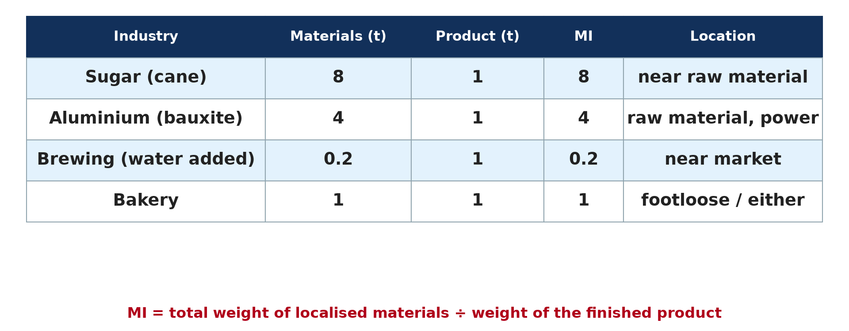
2. PRINCIPLE OF MATERIAL INDEX
Activity 3
Material index examples.
Notes:
Activity 3. Look carefully at this diagram: material index examples. Observe every detail before I ask the question.

Slide 26
2. PRINCIPLE OF MATERIAL INDEX
Activity 3: Question
A sugar mill uses 8 t of cane to make 1 t of sugar. Where should it be?
Notes:
Here is the question for Activity 3: A sugar mill uses 8 t of cane to make 1 t of sugar. Where should it be? Take one minute to think and write your answer in your rough notebook.

Slide 27
2. PRINCIPLE OF MATERIAL INDEX
Activity 3: Answer
MI = 8 > 1, so near the cane fields.
Notes:
Let us check the answer together. MI = 8 > 1, so near the cane fields.

Slide 28
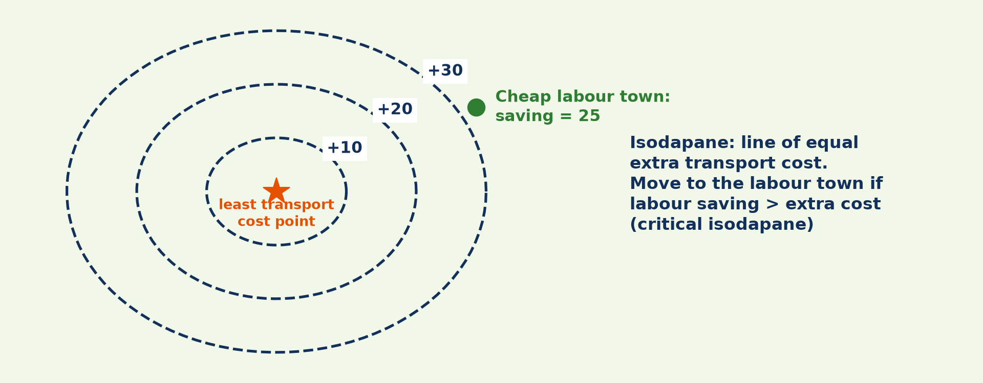
3. LOCATION FACTORS: LABOUR
Activity 4
Isodapanes and cheap labour.
Notes:
Activity 4. Look carefully at this diagram: isodapanes and cheap labour. Observe every detail before I ask the question.

Slide 29
3. LOCATION FACTORS: LABOUR
Activity 4: Question
When will a firm move to a cheap-labour town?
Notes:
Here is the question for Activity 4: When will a firm move to a cheap-labour town? Take one minute to think and write your answer in your rough notebook.

Slide 30
3. LOCATION FACTORS: LABOUR
Activity 4: Answer
When labour savings are greater than extra transport costs.
Notes:
Let us check the answer together. When labour savings are greater than extra transport costs.

Slide 31
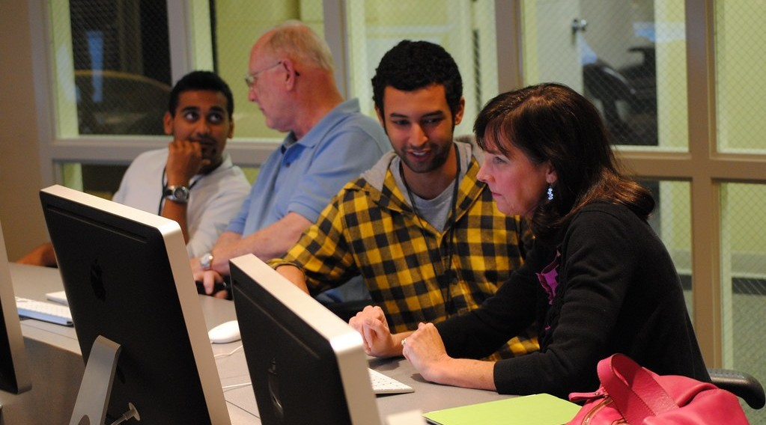
4. APPLICABILITY AND CRITICISMS
Activity 5
Skilled workers in a modern firm.
Notes:
Activity 5. Look carefully at this picture: skilled workers in a modern firm. Observe every detail before I ask the question.

Slide 32
4. APPLICABILITY AND CRITICISMS
Activity 5: Question
Give two criticisms of Weber's model.
Notes:
Here is the question for Activity 5: Give two criticisms of Weber's model. Take one minute to think and write your answer in your rough notebook.

Slide 33
4. APPLICABILITY AND CRITICISMS
Activity 5: Answer
Transport costs are less important today; it ignores demand and government.
Notes:
Let us check the answer together. Transport costs are less important today; it ignores demand and government.

Slide 34
BOARD SUMMARY
Board Summary
Topic: Theories of Industrial Location
Sub-topic: Theories of Industrial Location
Lesson 23: Weber's Least-Cost Model
Notes:
Now we are going to copy the board summary. Write the title and the headings neatly in your notebooks. I will give you enough time for each slide, so do not rush.

Slide 35
BOARD SUMMARY
1. Aim and Assumptions
Weber's model (1909) can be introduced as follows:
Aim: Alfred Weber wanted to find the least-cost location of a factory. He believed transport cost was the most important factor.
Notes:
Let us copy Aim and Assumptions. Weber's model (1909) can be introduced as follows. On this slide we have Aim. Write each point on a new line, with the key term first, and explain it in your own words when we revise. When you finish, we go to the next slide.

Slide 36
BOARD SUMMARY
1. Aim and Assumptions (continued)
Assumptions: An isolated country with uniform relief, climate and culture, fixed raw material sources and markets. Transport costs depend on weight and distance, and labour is available at fixed places.
Notes:
We continue with Aim and Assumptions. On this slide we have Assumptions. Write each point on a new line, with the key term first, and explain it in your own words when we revise.

Slide 37
BOARD SUMMARY
2. Principle of the Material Index
The material index guides location:
Material index (MI): MI = total weight of localised raw materials ÷ weight of the finished product. It shows whether the industry loses or gains weight.
Notes:
Let us copy Principle of the Material Index. The material index guides location. On this slide we have Material index (MI). Write each point on a new line, with the key term first, and explain it in your own words when we revise. When you finish, we go to the next slide.

Slide 38
BOARD SUMMARY
2. Principle of the Material Index (continued)
Interpretation: If MI > 1, the industry locates near raw materials (sugar, aluminium). If MI < 1, it locates near the market (brewing, soft drinks).
Notes:
We continue with Principle of the Material Index. On this slide we have Interpretation. Write each point on a new line, with the key term first, and explain it in your own words when we revise. When you finish, we go to the next slide.

Slide 39
BOARD SUMMARY
2. Principle of the Material Index (continued)
Location triangle: With two raw materials and one market, the least-cost location is the point in the triangle with the lowest total ton-kilometres. Weber found it by weighing the pull of each corner of the triangle.
Notes:
We continue with Principle of the Material Index. On this slide we have Location triangle. Write each point on a new line, with the key term first, and explain it in your own words when we revise.

Slide 40
BOARD SUMMARY
2. Principle of the Material Index
Illustration: Weber's location triangle
Notes:
Now draw this illustration in your notebook: weber's location triangle. Give it a title and label it clearly.

Slide 41
BOARD SUMMARY
3. Location Factors, Applicability and Criticisms
Weber also considered other factors:
Labour and agglomeration: A firm moves to a cheap-labour site if the labour saving is greater than the extra transport cost (critical isodapane). Agglomeration savings can also attract it.
Notes:
Let us copy Location Factors, Applicability and Criticisms. Weber also considered other factors. On this slide we have Labour and agglomeration. Write each point on a new line, with the key term first, and explain it in your own words when we revise. When you finish, we go to the next slide.

Slide 42
BOARD SUMMARY
3. Location Factors, Applicability and Criticisms (continued)
Applicability: The model explains heavy industries such as steel, sugar and cement. It introduced useful tools such as the material index.
Notes:
We continue with Location Factors, Applicability and Criticisms. On this slide we have Applicability. Write each point on a new line, with the key term first, and explain it in your own words when we revise. When you finish, we go to the next slide.

Slide 43
BOARD SUMMARY
3. Location Factors, Applicability and Criticisms (continued)
Criticisms: Transport costs are less important today and are not proportional to distance. The model ignores demand, government policy and human behaviour.
Notes:
We continue with Location Factors, Applicability and Criticisms. On this slide we have Criticisms. Write each point on a new line, with the key term first, and explain it in your own words when we revise.

Slide 44
BOARD SUMMARY
3. Location Factors, Applicability and Criticisms
Illustration: isodapanes and labour location
Notes:
Now draw this illustration in your notebook: isodapanes and labour location. Give it a title and label it clearly.

Slide 45
FORMATIVE EVALUATION
Evaluation 1
What does MI > 1 mean?
Notes:
Now let us check what you have understood. Question 1: What does MI > 1 mean? Answer in your exercise book.

Slide 46
FORMATIVE EVALUATION
Expected Answer
The materials lose weight, so the factory locates near raw materials.
Notes:
The expected answer is: the materials lose weight, so the factory locates near raw materials. If you got it right, well done.

Slide 47
FORMATIVE EVALUATION
Evaluation 2
Give two criticisms of Weber's model.
Notes:
Now let us check what you have understood. Question 2: Give two criticisms of Weber's model. Answer in your exercise book.

Slide 48
FORMATIVE EVALUATION
Expected Answer
It overstates transport cost; it ignores demand and government.
Notes:
The expected answer is: it overstates transport cost; it ignores demand and government. If you got it right, well done.

Slide 49
REMEDIATION
Remediation
Fill in the blanks:
MI < 1 means locate near the ______.
A line of equal extra transport cost is an ______.
Weber sought the ______-cost location.
Notes:
For those who need more practice, fill in the blanks in your exercise book. The answers are: number 1, market; number 2, isodapane; number 3, least.

Slide 50
HOMEWORK
Homework
Calculate the MI of two industries and state their best location.
Notes:
For your homework: Calculate the MI of two industries and state their best location. We shall correct it at the beginning of our next lesson.

Slide 51
NEXT LESSON
Next Lesson
Our next lesson will be on:
Practical Work 3: Material Index, Location Triangles and Isodapanes
Notes:
Our next lesson will be on Practical Work 3: Material Index, Location Triangles and Isodapanes. Thank you for your attention, and see you next time.

Slide 52
BILINGUAL GAME
Bilingual Game (Jeu Bilingue)
English | Français
Least cost | Le moindre coût
Material index | L'indice matière
Triangle | Le triangle
Weight | Le poids
Isodapane | L'isodapane
Labour cost | Le coût de la main-d'œuvre
Notes:
Let us play the bilingual game. I say a word in English, and you give me the French word. Then we do the reverse.

Slide 53
LOGBOOK
Official Logbook (1/2)
Module / Topic | Theories of Industrial Location
Lesson Title | Lesson 23: Weber's Least-Cost Model
Expected Learning Outcomes | State the aim and assumptions of Weber's model. Explain the material index and the location triangle. Explain labour and agglomeration and assess the model.
Competence | Learners are able to explain Weber's model and assess it.
Notes:
I record this information in the official logbook of the class after the lesson.

Slide 54
LOGBOOK
Official Logbook (2/2)
Matter Taught | Aim and Assumptions; Principle of the Material Index; Location Factors, Applicability and Criticisms.
Evaluation | Formative evaluation and remediation exercise.
Homework | Calculate the MI of two industries and state their best location.
Enrolment / Present / Absent | ____ / ____ / ____
Achievement | To be completed after the lesson.
Notes:
I complete the second page of the logbook: the matter taught, the evaluation, the homework and the attendance.

Slide 55
TEACHER'S NOTE
Teacher's Note
Timing: Homework correction, plan, objectives 8 min | Recall, situation, action 10 min | 5 activities 30 min | Board summary (copying) 30 min | Evaluation, remediation 10 min | Homework, next lesson 5 min | Logbook 7 min
Without the projector (Activity 1): list assumptions.
Without the projector (Activity 2): draw the triangle.
Without the projector (Activity 3): calculate MI.
Without the projector (Activity 4): explain the critical isodapane.
Without the projector (Activity 5): list criticisms.
Notes:
This slide is for me, the teacher: it gives the timing of the lesson and what to do if the projector is not available.

Slide 56
REFERENCES
References
National Geography Syllabus, MINESEC/IGE/IP-SS, 2019 — Module 6 (Economic Geography).
Photo, Activity 1: “Blue Wildebeest in the Lowveld” by Martin_Heigan, CC BY-NC-ND 2.0, via Flickr (https://www.flickr.com/photos/97303475@N00/2089079933)
Photo, Activity 5: “Knight-Crane Convergence Lab” by Knight Foundation, CC BY-SA 2.0, via Flickr (https://www.flickr.com/photos/9133668@N08/6242015734)
Diagrams and animations: drawn for this lesson (Geography Department).
Notes:
These are the references and picture credits used to prepare this lesson.

